Slide 1
Cricket League Database – IPL 2020 Project Presentation for MET CS 579 A1
Instructor Name: Professor John Russo
Student Name: Naman Singhal

Slide 2
Overview
Creating a database for the Indian Premier League 2020.
Getting popular statistics like a player’s Batting Average using SQL queries

Slide 3
A little about the game
2 teams, 2 aspects: Batting, Bowling(Fielding)
The team batting first will have to score “runs” in a limited number of balls(120).
The team batting second will have to chase(i.e., make more runs than the other team made) the target to win. The team batting first will have to defend the target to win.
The bowlers of fielding team will be bowling to the batsmen of batting team, trying to restrict the number of runs they can score.

Slide 4
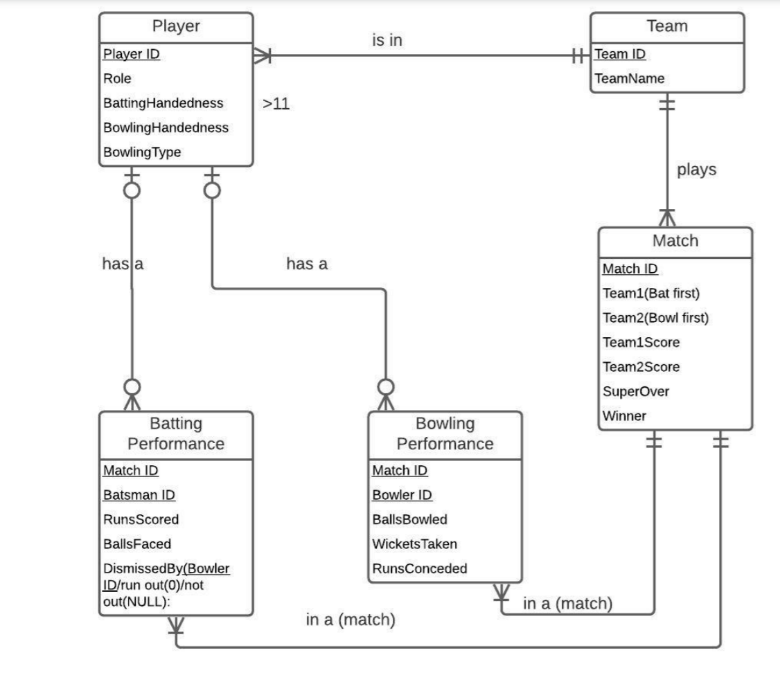
ER Diagram

Slide 5
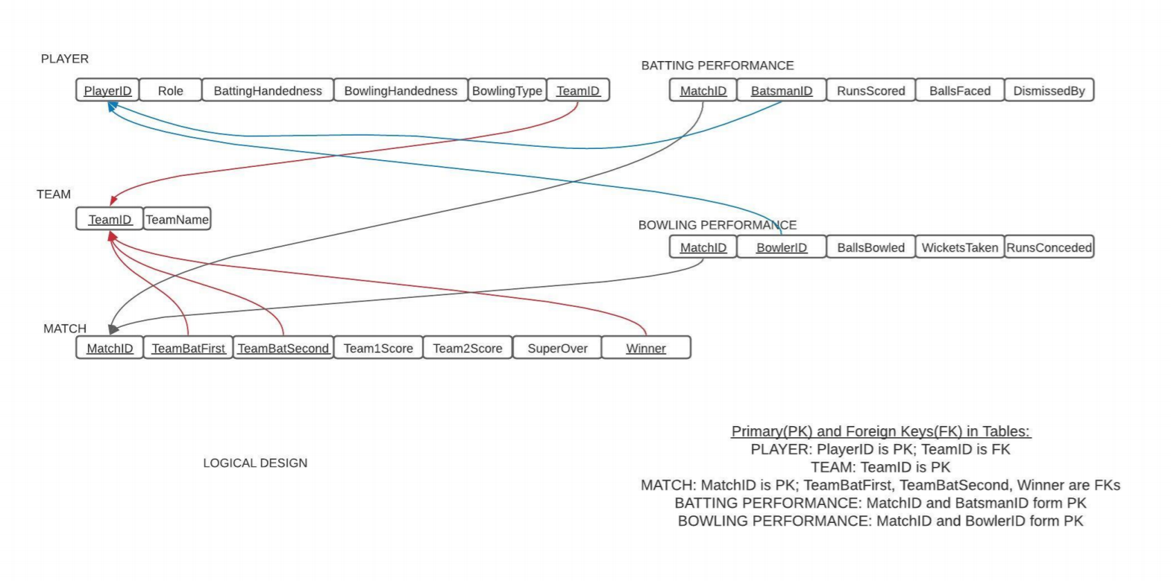
Logical Design

Slide 6
Sample script for table creation
create table BattingPerformance_T
(MatchID varchar2(5) not null,
BatsmanID varchar2(6) not null,
RunsScored integer,
BallsFaced integer,
DismissedBy varchar2(6),
constraint BattingPerformance_PK primary key (MatchID, BatsmanID),
constraint BattingPerformance_FK1 foreign key (MatchID) references Match_T(MatchID),
constraint BattingPerformance_FK2 foreign key (BatsmanID) references Player_T(PlayerID),
constraint BattingPerformance_FK3 foreign key (DismissedBy) references Player_T(PlayerID));
# Data loaded from csv files using bulk insert

Slide 7
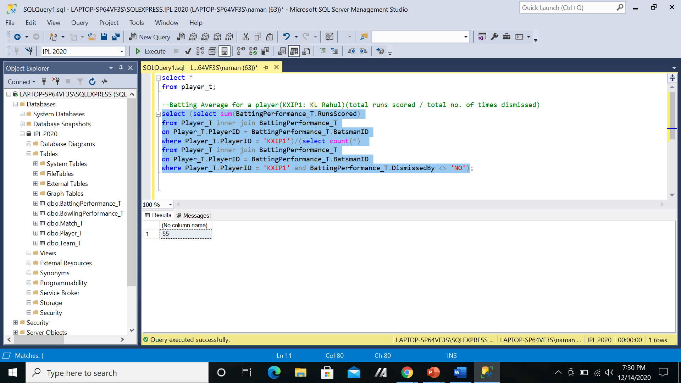
Queries for some stats(Batting Average, strike rate…)

Slide 8
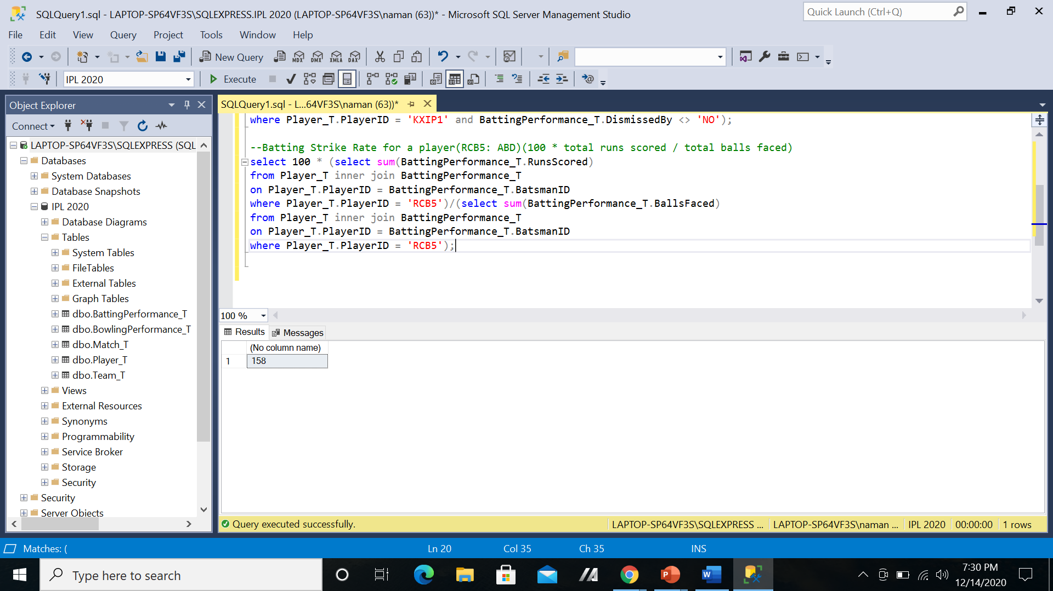

Slide 9
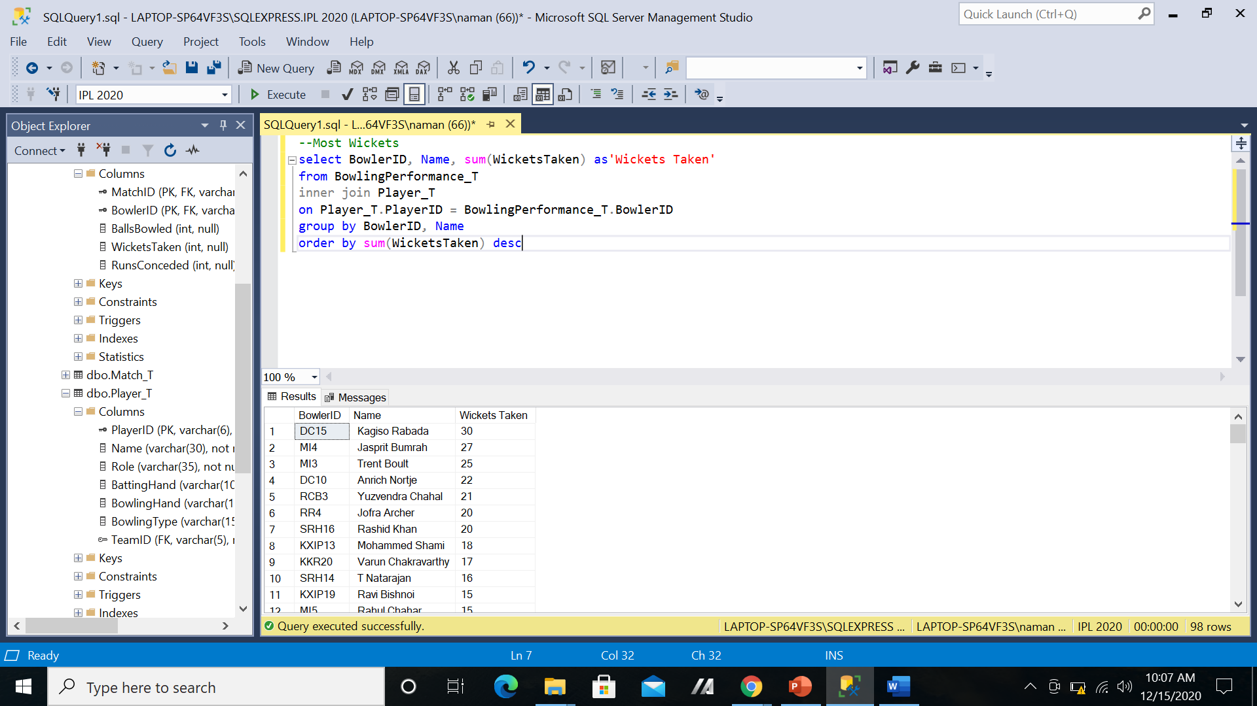

Slide 10
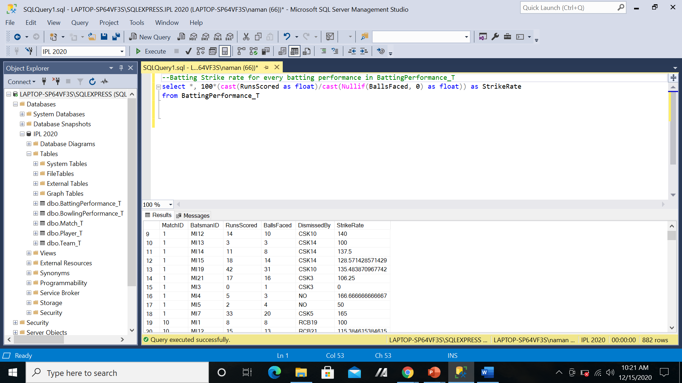
Initially thought of adding Strike Rate, Average as attributes, but those can be found out by simple queries:

Slide 11
Obstacles
Getting used to new environments(Microsoft SSMS, Oracle)
Getting the data(tried web scraping using Beautiful Soup library)(works but not very efficient for this project)
Error Handling(looked up ways to avoid errors like division by zero)

Slide 12
Future
Match Relative Statistics
Create and analyze data from similar sports database to develop useful insights.

Slide 13
Thank You ☺

